Slide 1

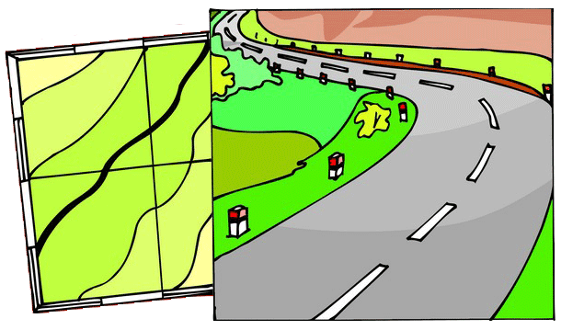
Architecture Roadmap
Planning for Agility, Reuse and Asset Consolidation

Slide 2

Goal
To draft an architecture blueprint and roadmap to dramatically increase business agility, increase reuse of the right assets and eliminate use of the wrong assets to optimize IT’s value and reduce costs.

Slide 3
Cross Functional Team
Functional Area | Resource
Enterprise Architecture | Jeff Wallk, Tony Sciacca
Demand Management | Ed Schipp, Bob Balogh, Dan Swanson, Bob Gerber
Support | Mike Slomanski, Joe Hendricks
App Dev (Non-SAP) | Jenny Hughs, Glenn Therkelsen, Mike Savatic
App Dev (SAP) | Cindy Swiatowiec
App Dev (Integration) | Jay Kolli, Chad LaCrosse
Operations | Craig Burnett, David Santiago, Holly Kay

Slide 4
Project Objectives:
Build a series of reference models from which to base technology decisions & deliver business services
Introduce a formal architecture development practice
Define a service-based model for delivering business value.
Establish ownership for the architecture domains (and document roles & responsibilies)
Define a set of architecture objectives
Define an architecture blueprint
Build a roadmap of projects to implement the blueprint

Slide 5
Scope for Initiative:
This short term initiative will only focus on the first few milestones (highlighted in blue below)*, where the reference models will provide a first pass (all we can hope to achieve with minimal effort at this time). We hope to recruit a set of 6 individuals who are willing to take a more active role in mapping out the architecture blueprint and roadmap so we can move with an action plan to help finalize the blueprint and begin moving forward with roadmapping initiatives throughout 2008 and beyond.
* Project Milestones:
  Draft the Value Proposition
  Draft the Architecture Objectives
  Draft the Reference Models
  Draft the Architecture Blueprint
  Draft the Architecture Roadmap

Slide 6
Approach:
Purpose:
Lay out a foundation and roadmap for establishing an architectural framework which aligns with industry (and vendor) standards to optimize our use of technology, accelerate our ability to deliver solutions and reduce the costs for delivering value to the business.
Commitment:
Requesting a few hours of time from the team over a period of 3-4 weeks.
Deliverables:
Schedule a series of Live Meetings in January-February timeframe based on availability. Jeff will prepare materials in advance so we can use these sessions as working meetings for review, feedback and to obtain approval for deliverables. Team members are asked to provide feedback and/or ask questions along the way.

